Slide 1



Trusted sla-guided data integration on multi-cloud environments
Daniel Aguiar da Silva Carvalho, Magellan, IAE, Université Jean Moulin Lyon3
Advisors
Chirine Ghedira Guegan, LIRIS, UMR5205, IAE, Université Jean Moulin Lyon3, France
Genoveva Vargas-Solar, CNRS, LIG-LAFMIA, France
Nadia Bennani, CNRS INSA-Lyon, LIRIS, UMR5205 - France

Slide 2
Agenda

Slide 3
Introduction
Daniel Aguiar da Silva Carvalho
Diplomas:
System analysis degree in the Federal Institute of Rio Grande do Norte, Brazil
Master degree in System and Computation in the Federal University of Rio Grande do Norte, Brazil
Internships and projects:
4-months Internship at UDELAR, Uruguay
National Research Network, Brazil
3rd year of PhD in the University of Lyon (Magellan Lab, Lyon3)

Slide 4
Research context: data integration
Query
Result
Data integration: the teenage years. Halevy, A., Rajaraman, A., & Ordille, J. (VLDB 2006, September)
Schema integration: Past, present, and future (Ram, S., & Ramesh, V. 1999)
Global schema
Mediator
Query rewriting
Data integration architectures:
Multi-databases, federations, DW, …
(Domenig & Dittrich 1999 Sigmod Record)
MiniCon algorithm for query rewriting (Pottinger and Halevy, 2001)
Exported schemata
Data
source A
Data
source B
Data
source C
Heterogeneous data sources known in advance

Slide 5
Research context: data integration
Services lookup and matching
[1] Paolucci, M., Kawamura, T., Payne, T. R., & Sycara, K. (2002, June). Semantic matching of web services capabilities. In International Semantic Web Conference (pp. 333-347). Springer Berlin Heidelberg.
[2} Bramantoro, A., Krishnaswamy, S., & Indrawan, M. (2005, November). A semantic distance measure for matching web services. In International Conference on Web Information Systems Engineering (pp. 217-226). Springer Berlin Heidelberg.
[3} APA Maximilien, E. M., & Singh, M. P. (2004, November). Toward autonomic web services trust and selection. In Proceedings of the 2nd international conference on Service oriented computing (pp. 212-221). ACM.
Query
Result
Mediator
Query rewriting techniques adapted to service composition
Exported API
[4] Barhamgi, M., Benslimane, D., and Medjahed, B. (2010). A query rewriting approach for web service composition. IEEE T. Services Computing, 3(3):206–222.
[5] da Costa, U. S., Alves, M. H. F., Musicante, M. A., and Robert, S. (2013). Automatic refinement of service compositions. In Daniel, F., Dolog, P., and Li, Q., editors, ICWE, volume 7977 of Lecture Notes in Computer Science, pages 400–407. Springer.
[6] Zhao, W., Liu, C., and Chen, J. (2011). Automatic composition of information-providing web services based on query rewriting. Science China Information Sciences, pages 1–17.
. . .
Distributed data services

Slide 6
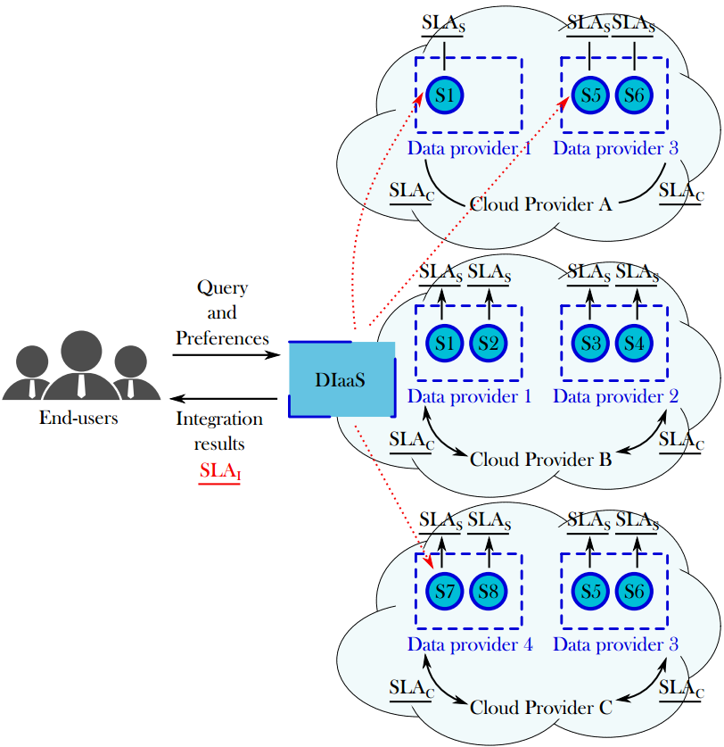
Target scenario: Challenges
  Which services should I select ? Are the requirements being respected?
  How to be sure that all SLAs are being respected?
  How to integrate different SLAs associated to services involved with user’s requirements?
  How results can be reused for a next query?
Objective
Propose a data integration solution in a multi-cloud environment guided by user requirements and SLA exported by different clouds

Slide 7
Results and contributions
Approach: Address data integration considering data quality (freshness, provenance, cost, availability) properties & service level agreements (SLA)
Hypothesis:
  The data integration process is totally or partially externalized on different clouds that provide necessary resources under different conditions (SLA)
  Data can be retrieved from several data providers (i.e., services) with different quality properties

Slide 8
Results and contributions
SLA Derivation
Query Rewriting
# Create an SLA for the integration
Search for previous queries
Process the complete rewriting
Query Evaluation
# Rewriting considering SLA measures
Reusing results
Process rewriting
# Store the results
# SLA guided query optmization
# Execution

Slide 9
Results and contributions
Rhone query rewriting algorithm¹ for data integration which considers user integration preferences and services’ quality aspects expressed in SLAs.
Selecting candidate concrete services
Creating candidate service descriptions (CSD)
Combinig CSDs
Producing rewritings
¹ D. A. S. Carvalho, P. A. S. Neto, C. Ghedira, G. Vargas-Solar, N. Bennani. Rhone: a quality-based query rewriting algorithm for data integration. East-European Conference on Advances in Databases and Information Systems, Aug 2016, Prague, France. ADBIS East-European Conference on Advances in Databases and Information Systems, 2016.

Slide 10
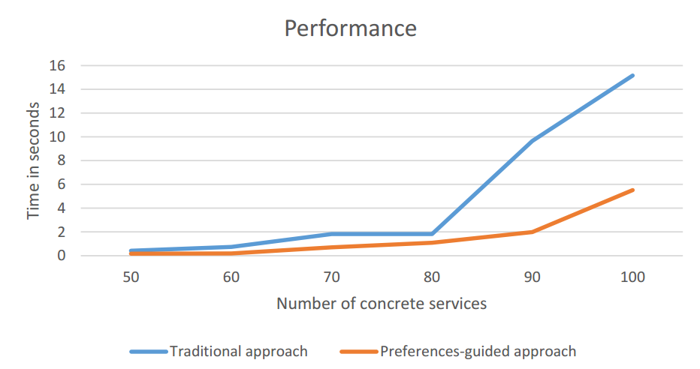
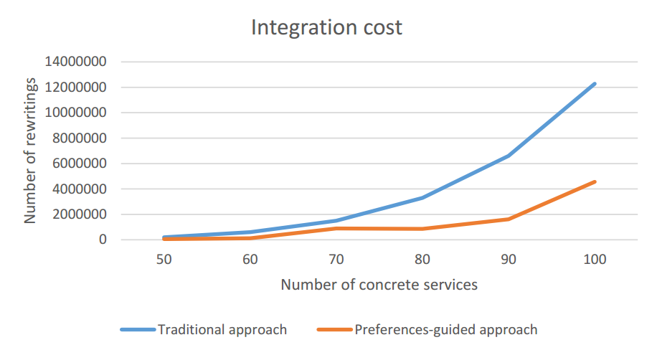
Results and contributions
Rhone query rewriting algorithm implementation and evaluation:
  Cloud simulation including 100 services
  Expensive while combining services: O(n^{k})
  Performance increased reducing the number of rewriting solutions and integration execution time
  Integration economic cost potentially reduced
Notes:
Based on the experimental validation, we can show you the Rhones’ profile
We can see the complexity of the different phases. As in the other algorithms, the most expensive step is the combination. It depends on the size of the query and the number of concrete service that could be mapped to the query.
The results of our experimental validation are illustrated by these two charts.
The performance increased by reducing the number of rewriting solutions and integration execution time. As we can see in the chart on the left.
Rewritring solutions quality enhanced and the integration economic cost is reduced once only rewriting that satisfies the user preferences are produced. As we can see in the chart on the right.
Click

Slide 11
Results and contributions
Data integration metamodel¹ and SLA schemas:
  Design of a metamodel for data integration
  Design of a cloud SLA (that is an agreement between a data service
  and a cloud provider) and a service SLA (that is a new kind of agreement defined
  by data services exposing the properties of the data they provide)
¹ D. A. S. Carvalho, P. A. S. Neto, C. Ghedira, G. Vargas-Solar, N. Bennani. Towards Quality Guided Data Integration on Multi-Cloud Settings. 14th international conference on service oriented computing (ICSOC), Oct 2016, Banff, Alberta, Canada.
Notes:
Based on the experimental validation, we can show you the Rhones’ profile
We can see the complexity of the different phases. As in the other algorithms, the most expensive step is the combination. It depends on the size of the query and the number of concrete service that could be mapped to the query.
The results of our experimental validation are illustrated by these two charts.
The performance increased by reducing the number of rewriting solutions and integration execution time. As we can see in the chart on the left.
Rewritring solutions quality enhanced and the integration economic cost is reduced once only rewriting that satisfies the user preferences are produced. As we can see in the chart on the right.
Click

Slide 12
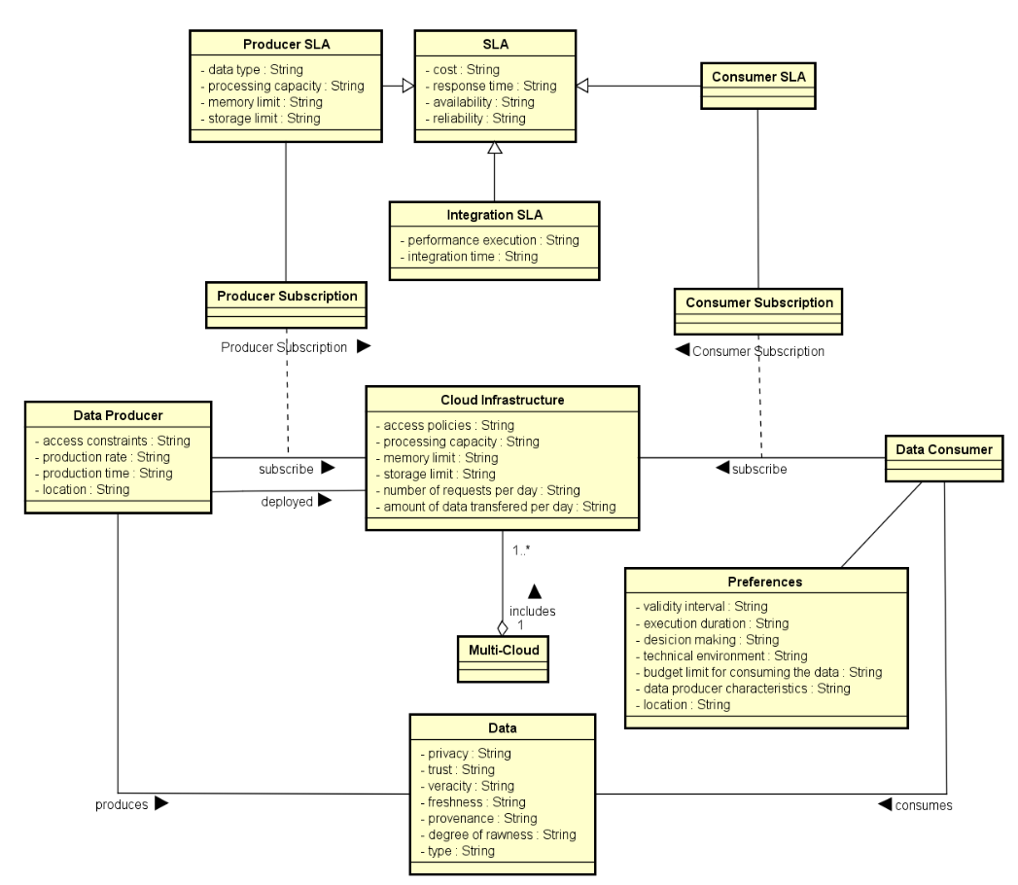
¹ D. A. S. Carvalho, P. A. S. Neto, C. Ghedira, G. Vargas-Solar, N. Bennani. Towards Quality Guided Data Integration on Multi-Cloud Settings. 14th international conference on service oriented computing (ICSOC), Oct 2016, Banff, Alberta, Canada.
Notes:
Based on the experimental validation, we can show you the Rhones’ profile
We can see the complexity of the different phases. As in the other algorithms, the most expensive step is the combination. It depends on the size of the query and the number of concrete service that could be mapped to the query.
The results of our experimental validation are illustrated by these two charts.
The performance increased by reducing the number of rewriting solutions and integration execution time. As we can see in the chart on the left.
Rewritring solutions quality enhanced and the integration economic cost is reduced once only rewriting that satisfies the user preferences are produced. As we can see in the chart on the right.
Click

Slide 13
Results and contributions
A method for service and composition selection:
  We have started working on an heuristic to rank data services and compositions based on SLA measures concerning service properties (percentage of availability, response time, throughput and others) and data properties (data type, freshness, veracity, provenance and others).
  Score of a data service ds, denoted S(ds) would be the weighted sum of the its measures scores.
$\frac{Mactual − Mmin}{Mmax − Mmin}$ (if M is a positive measure)
$$Smeasure\left(M\right)=$$
$\frac{Mmax − Mactual}{Mmax − Mmin}$ (if M is a negative measure)
Notes:
Based on the experimental validation, we can show you the Rhones’ profile
We can see the complexity of the different phases. As in the other algorithms, the most expensive step is the combination. It depends on the size of the query and the number of concrete service that could be mapped to the query.
The results of our experimental validation are illustrated by these two charts.
The performance increased by reducing the number of rewriting solutions and integration execution time. As we can see in the chart on the left.
Rewritring solutions quality enhanced and the integration economic cost is reduced once only rewriting that satisfies the user preferences are produced. As we can see in the chart on the right.
Click

Slide 14

Results and contributions
Definition and formalization of a taxonomy of queries:
  We have defined and formalized a set of possible relations between queries which differ in terms of abstract services, service properties and data properties.
  For example, a query is defined as a tuple:
  where: s is status; t is the timestap; A is a set of abstract services defining the query; R is a set of user preferences; S is a set of data services; C is a set of compositions; and w is the composition that were selected to answer the query Q.
  Query type:
  Given two queries Q₁ and Q₂, Q₂ is a subset of Q₁ if:
Notes:
Based on the experimental validation, we can show you the Rhones’ profile
We can see the complexity of the different phases. As in the other algorithms, the most expensive step is the combination. It depends on the size of the query and the number of concrete service that could be mapped to the query.
The results of our experimental validation are illustrated by these two charts.
The performance increased by reducing the number of rewriting solutions and integration execution time. As we can see in the chart on the left.
Rewritring solutions quality enhanced and the integration economic cost is reduced once only rewriting that satisfies the user preferences are produced. As we can see in the chart on the right.
Click

Slide 15

Results and contributions
A method for reusing queries:
  Based on the proposed query taxonomy, we have designed and formalized a reusability approach which allows to reuse data services and compositions from previous integration in order to profit from them.
  Query type:
  Given two queries Q₁ and Q₂, Q₂ is a subset of Q₁ if:
  For this type, we are able to completely reuse Q₁ :
Notes:
Based on the experimental validation, we can show you the Rhones’ profile
We can see the complexity of the different phases. As in the other algorithms, the most expensive step is the combination. It depends on the size of the query and the number of concrete service that could be mapped to the query.
The results of our experimental validation are illustrated by these two charts.
The performance increased by reducing the number of rewriting solutions and integration execution time. As we can see in the chart on the left.
Rewritring solutions quality enhanced and the integration economic cost is reduced once only rewriting that satisfies the user preferences are produced. As we can see in the chart on the right.
Click

Slide 16
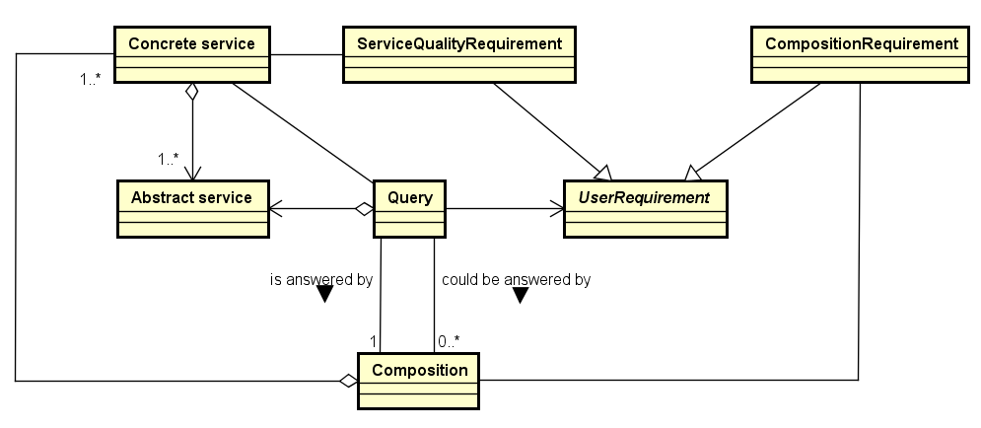
Results and contributions
Query history data model and implementation:
  Design and implementation of the query history data model, which includes queries, abstract services, data services and compositions
  Rhone algorithm was adapted to be in accordance with the model
Notes:
Based on the experimental validation, we can show you the Rhones’ profile
We can see the complexity of the different phases. As in the other algorithms, the most expensive step is the combination. It depends on the size of the query and the number of concrete service that could be mapped to the query.
The results of our experimental validation are illustrated by these two charts.
The performance increased by reducing the number of rewriting solutions and integration execution time. As we can see in the chart on the left.
Rewritring solutions quality enhanced and the integration economic cost is reduced once only rewriting that satisfies the user preferences are produced. As we can see in the chart on the right.
Click

Slide 17
Results and contributions
Future works:
  Implementing new algorithms to include reusability issues
  Concluding the heuristic approach adapted to the context
  Experiments: building a proof of concept to the approach
Notes:
Based on the experimental validation, we can show you the Rhones’ profile
We can see the complexity of the different phases. As in the other algorithms, the most expensive step is the combination. It depends on the size of the query and the number of concrete service that could be mapped to the query.
The results of our experimental validation are illustrated by these two charts.
The performance increased by reducing the number of rewriting solutions and integration execution time. As we can see in the chart on the left.
Rewritring solutions quality enhanced and the integration economic cost is reduced once only rewriting that satisfies the user preferences are produced. As we can see in the chart on the right.
Click

Slide 18
Professional and scientific activities
Day-to-day work:
  Currently attached to InfoMaths doctoral school (Lyon1) but working in the Magellan Research Center (Lyon3)
  Easy access to the advisors
  Regular meetings
    At least 1 meeting per week (face-to-face or in a conference call)
    Technical and scientific discussions: formalization exercises and experiment environment configuration
    The objective is to define next activities
Notes:
Based on the experimental validation, we can show you the Rhones’ profile
We can see the complexity of the different phases. As in the other algorithms, the most expensive step is the combination. It depends on the size of the query and the number of concrete service that could be mapped to the query.
The results of our experimental validation are illustrated by these two charts.
The performance increased by reducing the number of rewriting solutions and integration execution time. As we can see in the chart on the left.
Rewritring solutions quality enhanced and the integration economic cost is reduced once only rewriting that satisfies the user preferences are produced. As we can see in the chart on the right.
Click

Slide 19
Professional and scientific activities
2014.2 | 2015.1 | 2015.2 | 2016.1 | 2016.2 | 2017.1
French course
French course
French course
Courses
Workshop: Writing scientific papers
Magellan IS group
Magellan IS group
Magellan IS group
Presentations
LIRIS SOC team
Presentation ADBIS 2016
Poster ARC
Poster ARC
Thematic schools
Smart cities and Big Data
Publications
DEXA 2015
ADBIS 2016
AICCSA 2015
ICSOC 2016

Slide 20
Perspectives
Activities: | 02/17 | 03/17 | 04/17 | 05/17 | 06/17
Improving and correcting the query taxonomy and reusability approach formalization
Implementing and including in Rhone the reusability functions
Building the proof of concept to the approach
Writing a paper to ER 2017
Concluding the work concerning the heuristic for optimizing service selection and composition
Writing the final thesis document

Slide 21
Daniel Aguiar da Silva Carvalho, Magellan, IAE, Université Jean Moulin Lyon3
Advisors:
Chirine Ghedira Guegan, LIRIS, UMR5205, IAE, Université Jean Moulin Lyon3, France
Genoveva Vargas-Solar, CNRS, LIG-LAFMIA, France
Nadia Bennani, CNRS INSA-Lyon, LIRIS, UMR5205 - France

